Slide 1
Update Your Status
Social media workshop

Slide 2
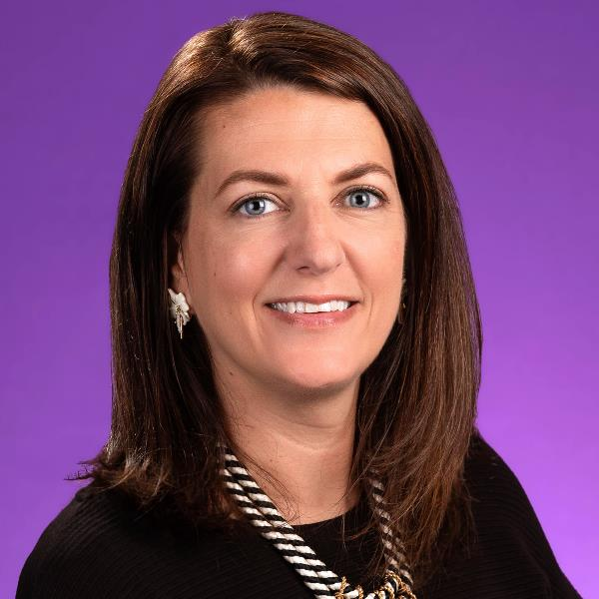
SOCIAL MEDIA TEAM
Digital Media Specialist
Social Media Specialist
SA - Chief of Communications
Kristin Zachary
Natalie Shrader-Pruitt
Emily McLamb

Slide 3
HOW TO DRIVE OUTCOMES
Research
Data and Insights
Channel Expertise
Strategy
Audience Focused
Continuous Improvement
Implementation
Channel Customization
Optimization
Message Sequencing
Channel Selection
Efficient | Effective | Exceed Expectations
Photo source: NC State

Slide 4
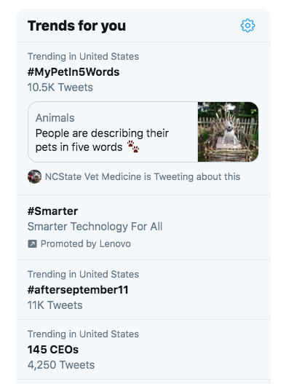
STAY TREND-Y
CAPITALIZE ON TRENDS TO PROPEL YOUR BRAND
In the world of going viral on social media, it is important for brands/organizations to stay on top of “viral trends” that they can personalize to their brand to propel themselves into the spotlight.
You don’t always have to use “viral” trends, though. General daily trends, as well as time-sensitive (newsworthy) trends, are also great ones on which to capitalize.
Use the tools you have available.
Twitter’s ”Trends for you” tab.
Follow accounts similar to your organization on both the local and national level to see what performs well for them.
Ask students what they like to see.

Slide 5
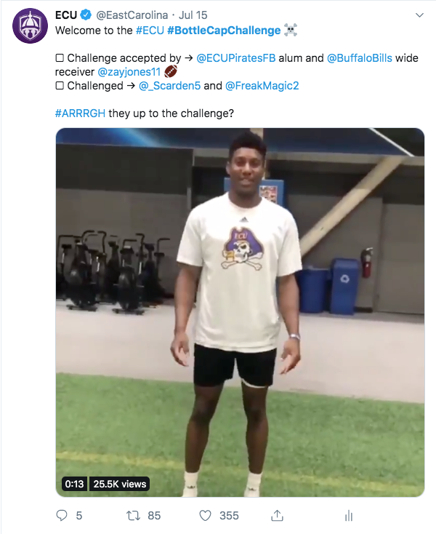
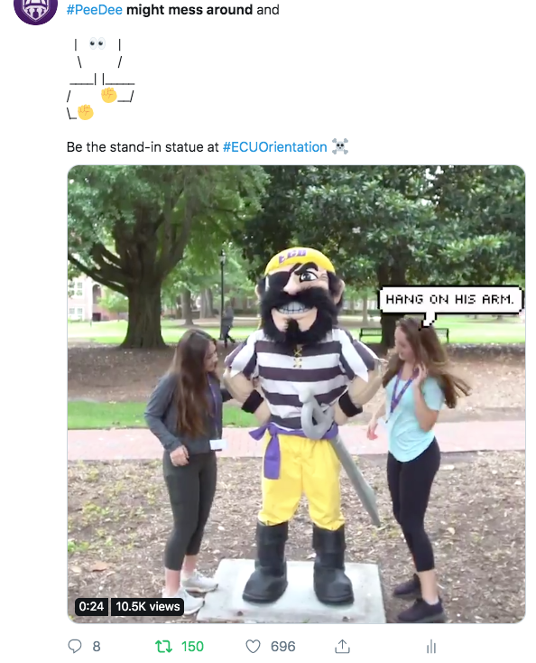
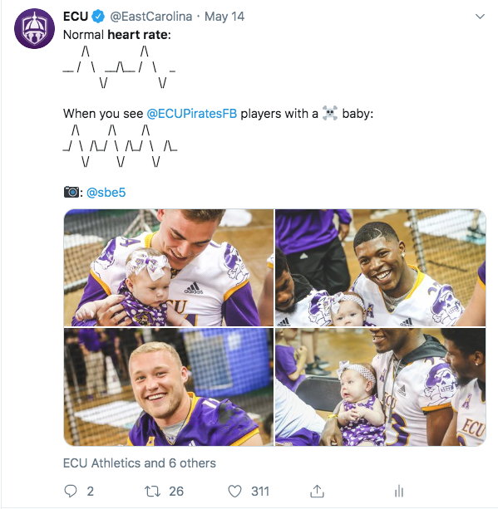
STAY TREND-Y
CAPITALIZE ON NATIONAL TRENDS
Three major trends we’ve capitalized on are:
Heart rate
The ”woah”
#BottleCapChallenge
Overall trends include:
#TBT
#MondayMotivation
Holidays
#MyPetIn5Words
#NationalVideoGamesDay

Slide 6
STAY TREND-Y
ECU OFFICIAL ACCOUNT – VIDEO TRENDS

Slide 7
STAY TREND-Y
ECU OFFICIAL ACCOUNT – VIDEO TRENDS

Slide 8
STAY TREND-Y
STUDENT AFFAIRS – VIDEO TRENDS

Slide 9
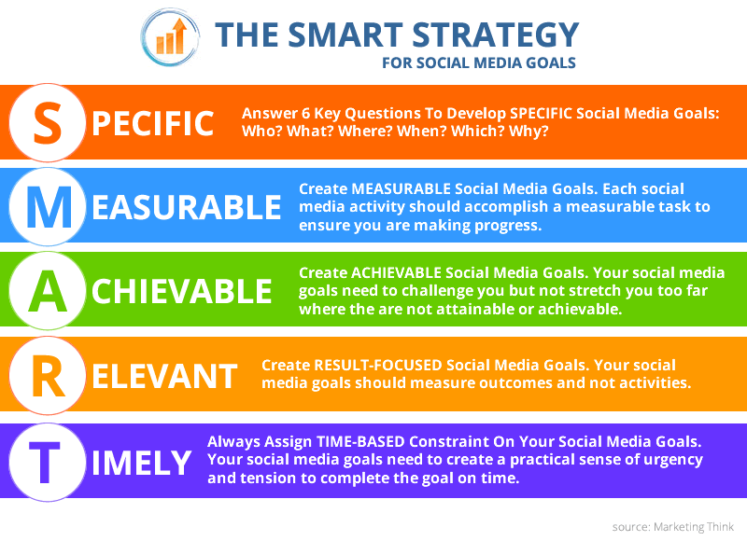
CREATING A SOCIAL MEDIA STRATEGY
SMART GOALS

Slide 10
The Social Media Funnel Break Down
01
AWARENESS
Brand awareness. This is the beginning level of the funnel where you shape the narrative of when people hear your division they think ________.
02
CONSIDERATION
You have the audience’s attention/have them interested in your “product.” You start ”pitching” them what you want them to buy/do.
PURCHASE
03
You have convinced them to act on what you’ve pitched to them. They become a “customer” of your “business.”
RETENTION / ADVOCACY
Your “client” advocates for your “business” through word-of-mouth referrals. You want to nurture that relationship to keep them advocating for you.
04

Slide 11
PLATFORM OVERVIEW
ROLES | CHARACTERISTICS | USE
FACEBOOK
TWITTER
INSTAGRAM
Role:
Connecting
Characteristics:
Visual | Mobile | Video
Use:
Influence | Authority
Role:
Conversing
Characteristics:
Real Time | Conversational
Use:
News | Relationships | Crisis
Role:
Inspiring
Characteristics:
Visual | Authentic | Mobile
Use:
Visually Brand

Slide 12
SOCIAL MEDIA SIZING
FACEBOOK | TWITTER | INSTAGRAM
FACEBOOK
TWITTER
INSTAGRAM
Dimensions:
1200x628
Tricks/Tips:
Shoot your photos + videos horizontally
Dimensions:
1200x675
600x335
Tricks/Tips:
Shoot your photos + videos horizontally
Dimensions:
POST: 1080x1080
STORY: 1080x1920
Tricks/Tips:
POST: Crop photo in app
STORY: Take photo vertically

Slide 13
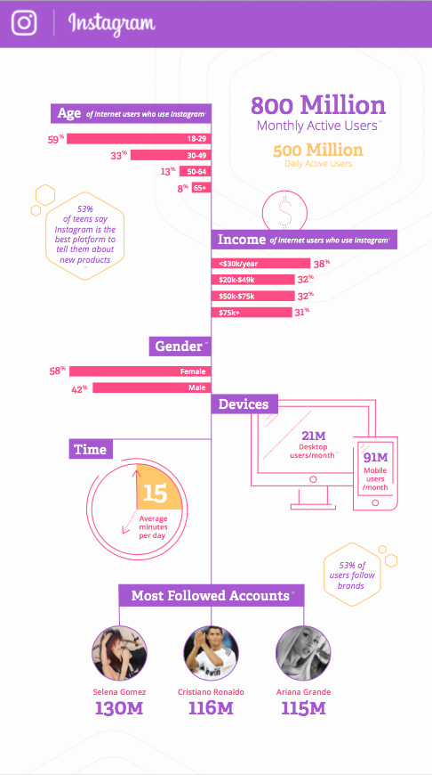
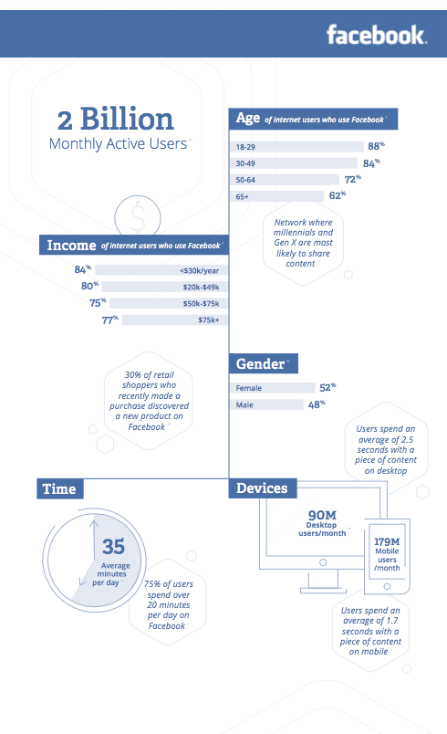
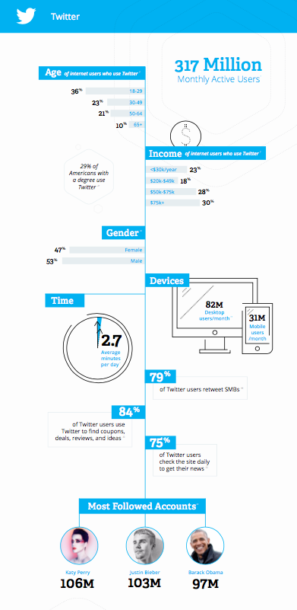
IDENTIFY YOUR AUDIENCE
CHOOSE APPROPRIATE PLATFORM
Photo source: Spredfast

Slide 14
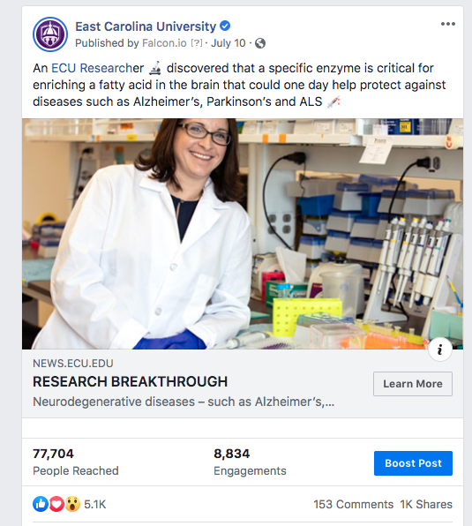
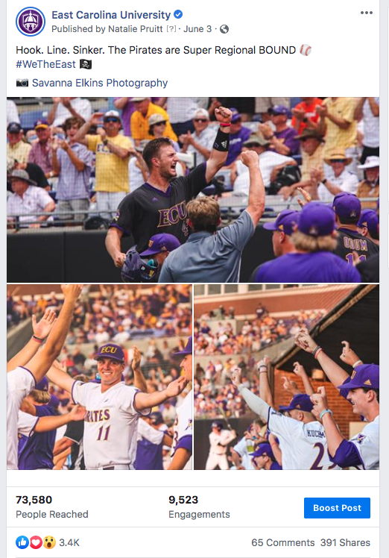
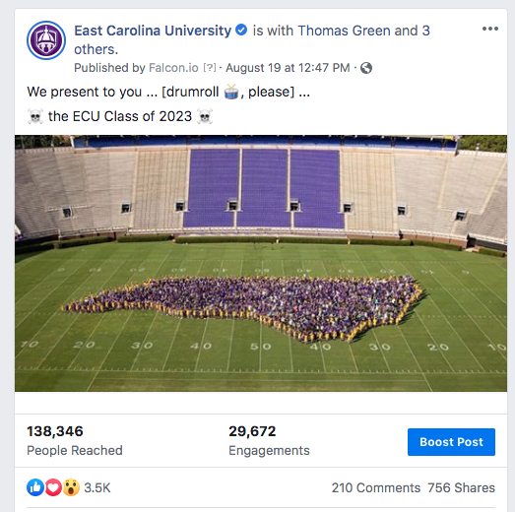
EXAMPLE SOCIAL MEDIA POSTS
ECU OFFICIAL ACCOUNT – FACEBOOK POSTS

Slide 15
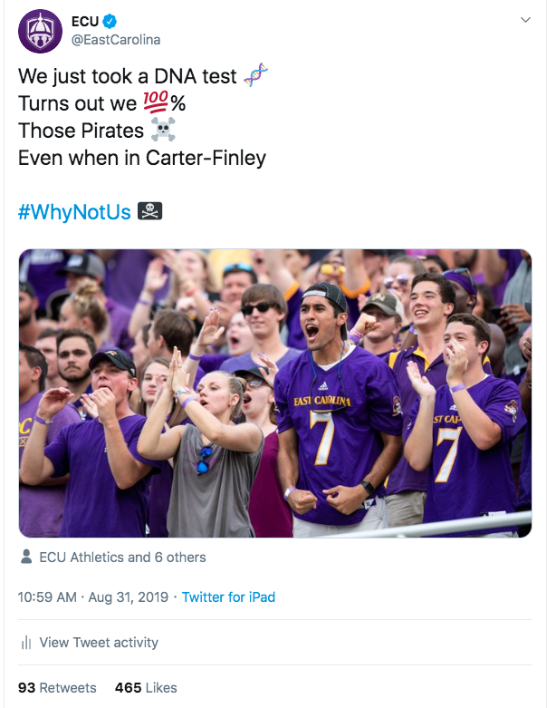
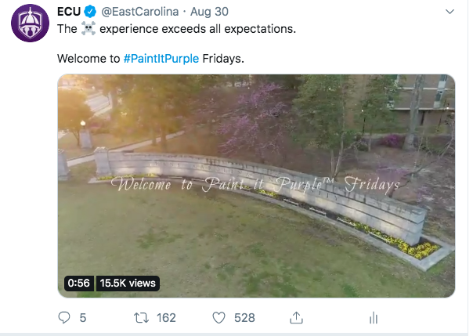
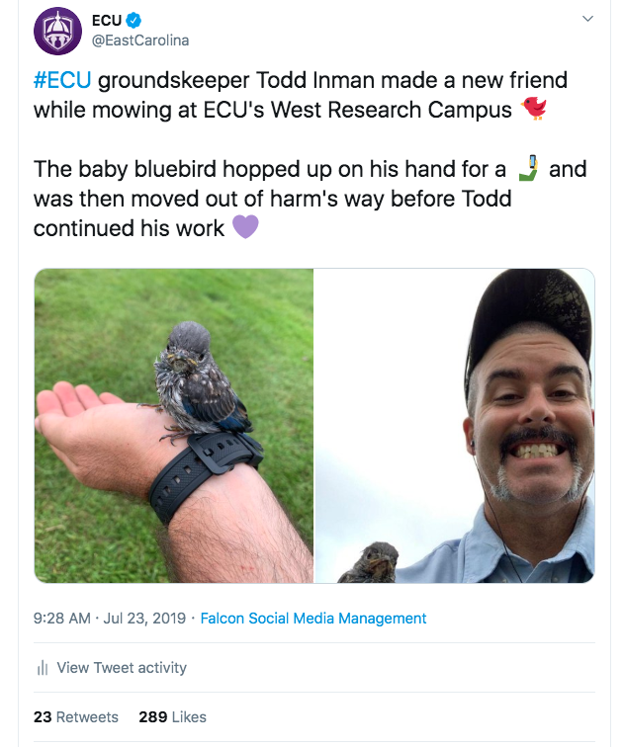
EXAMPLE SOCIAL MEDIA POSTS
ECU OFFICIAL ACCOUNT – TWITTER POSTS

Slide 16
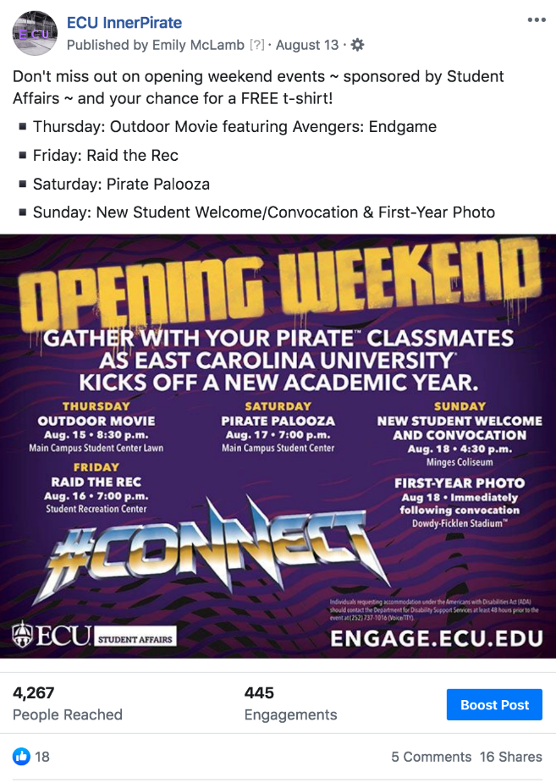
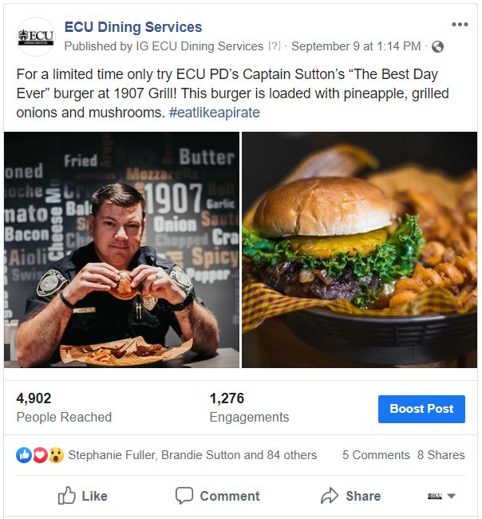
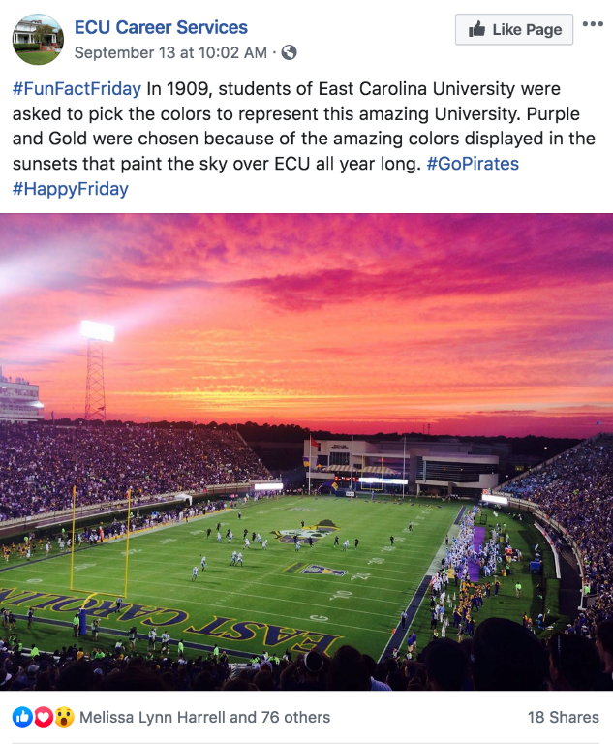
EXAMPLE SOCIAL MEDIA POSTS
STUDENT AFFAIRS – FACEBOOK POSTS

Slide 17
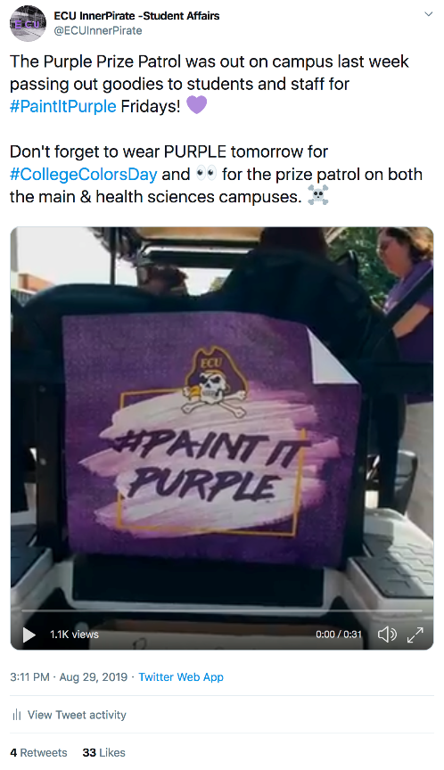
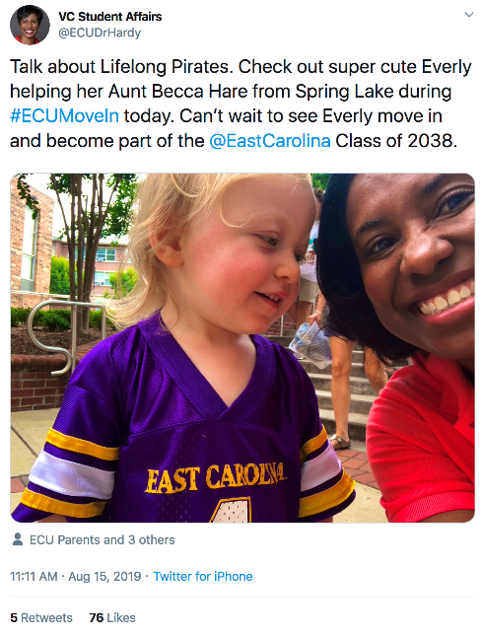
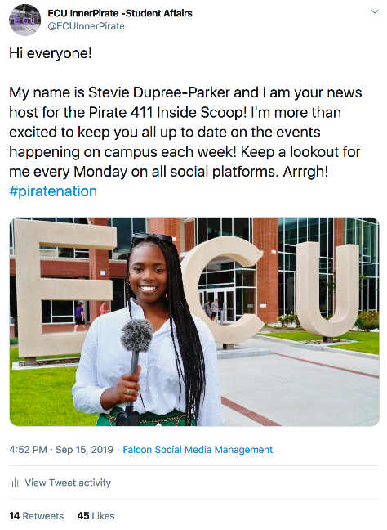
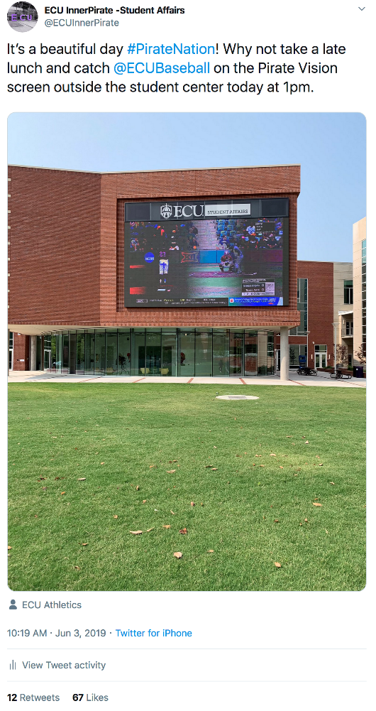
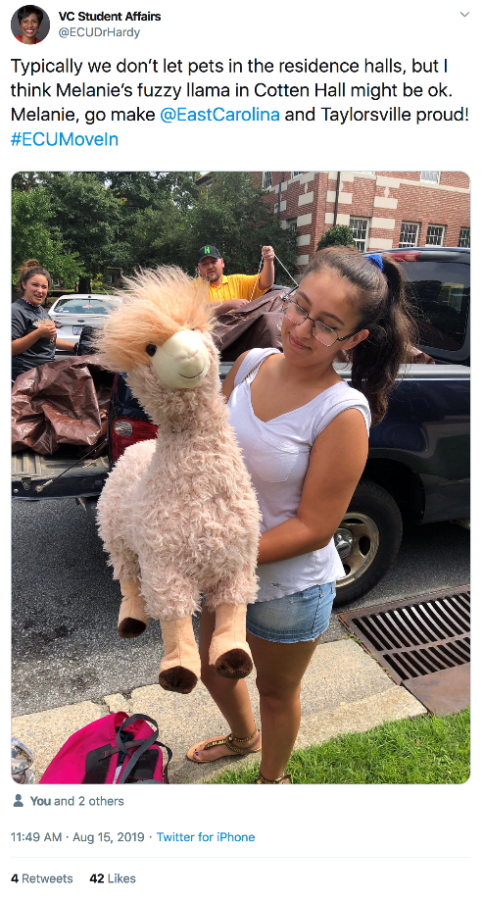
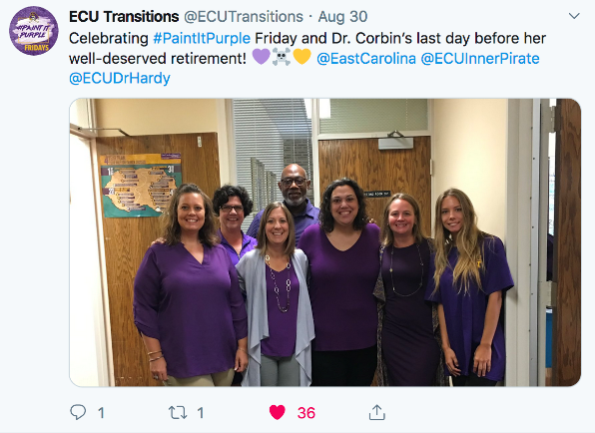
EXAMPLE SOCIAL MEDIA POSTS
STUDENT AFFAIRS – TWITTER POSTS

Slide 18
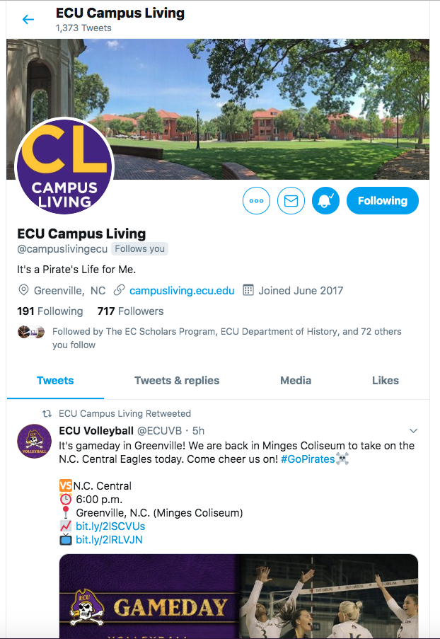
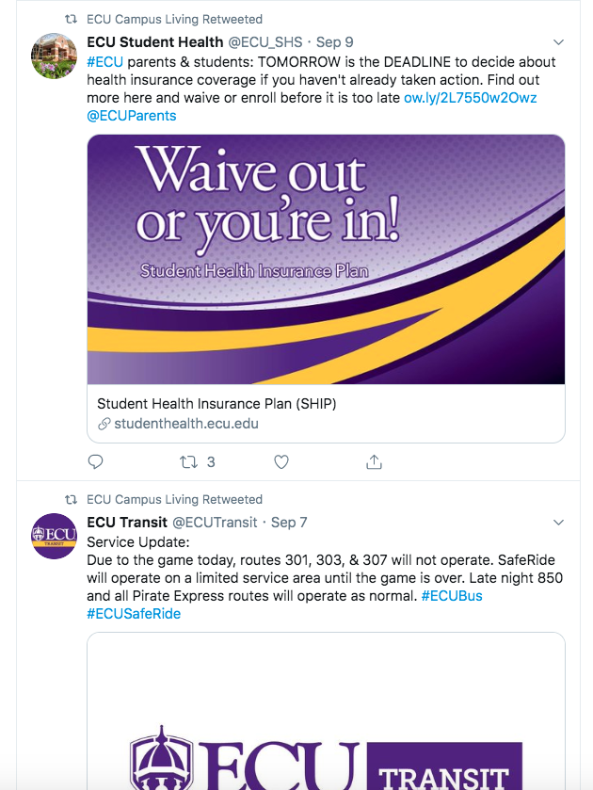
SOCIAL MEDIA BEST PRACTICES
TAGGING | EDITING | VISUAL
In an age of instant gratification, if something doesn’t catch the eye or “bores” the audience, they will keep moving to the next thing. You have about 5 seconds to hook the viewer.
With that in mind, you want to follow best practices:
Build tags/handles/hashtags INTO the copy
Double check all tags are correct/go to the right account(s)
Break up long copy into different paragraphs + utilize emojis
Copy edit – two sets of eyes on every post
GET VISUAL – size your visuals correctly
Interact and advocate for other university accounts.

Slide 19
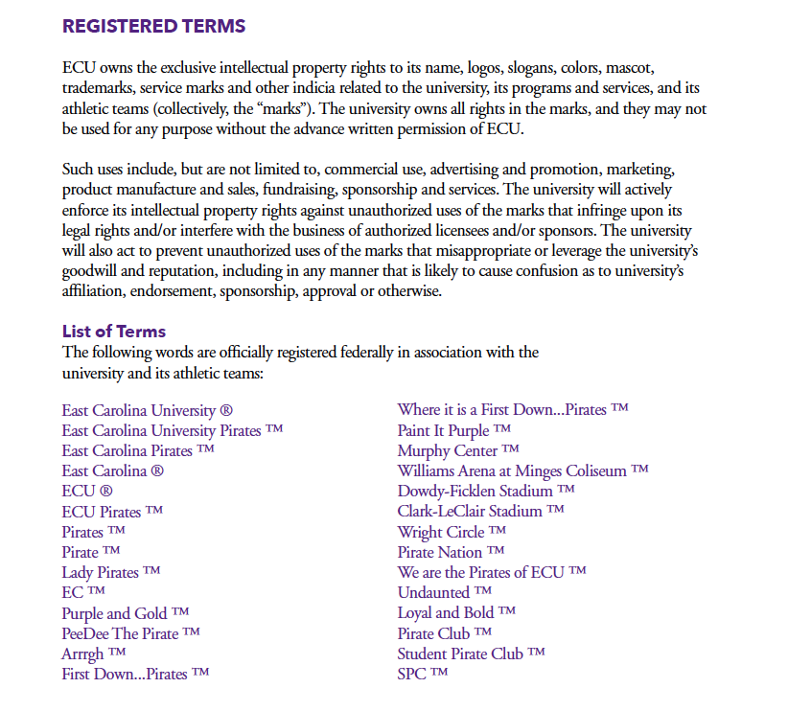
CREATIVE SERVICES
LOGO REVIEW | TICKETS | BRANDING
Trademarked graphics and terms
University colors
Diversity

Slide 20
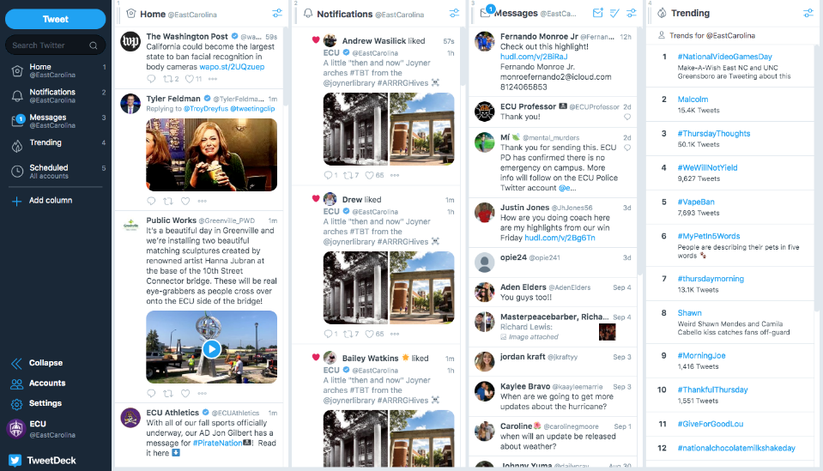
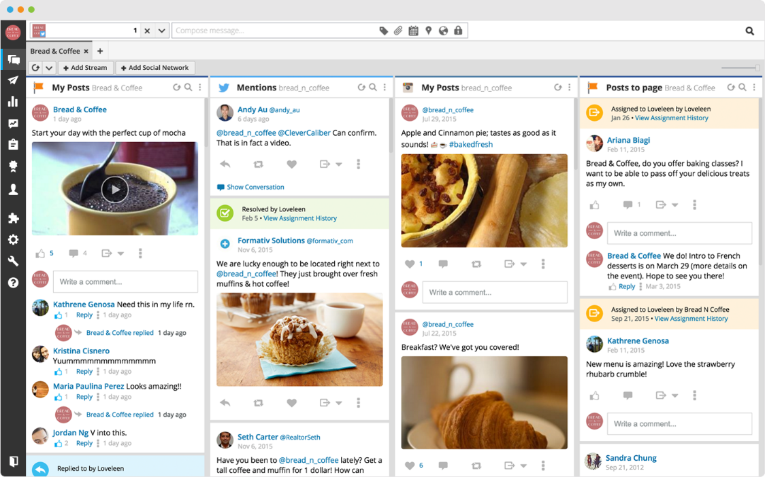
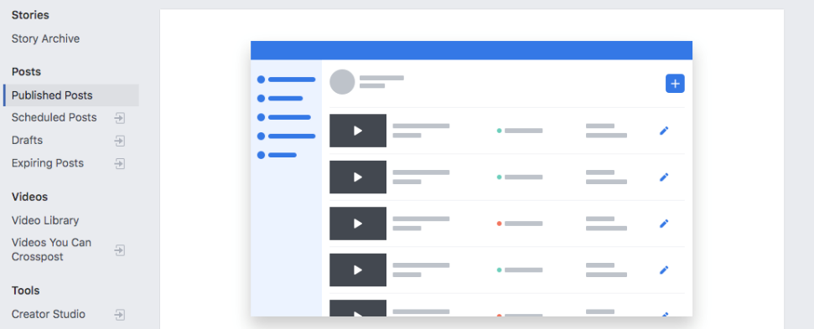
STAY ACTIVE
SCHEDULING CONTENT
Staying active is important, but it can be tedious. This is where using scheduling software can be helpful.
Free: Affordable:

Slide 21
MEASURING SOCIAL MARKETING
APPLAUSE | CONVERSATION | AMPLIFICATION
Measuring social marketing can help drive content strategy and provide an overall evaluation of what your content means to your audience on different platforms.
Accurately measuring social marketing can help you deliver the right content to the right audience at the right time.
Each platform serves a different audience, but measuring all platforms through common buckets can help streamline discussions about what’s working:
APPLAUSE
WHY - Find out what people like
WHAT - Favorites, likes, hearts
CONVERSATION
WHY - Find out what people want to talk to you about
WHAT - Comments, replies
AMPLIFICATION
WHY - Find out what people are willing to advocate for
WHAT - Shares, retweets

Slide 22
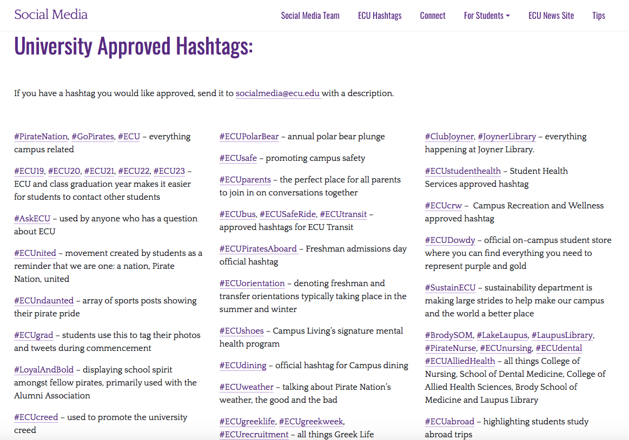
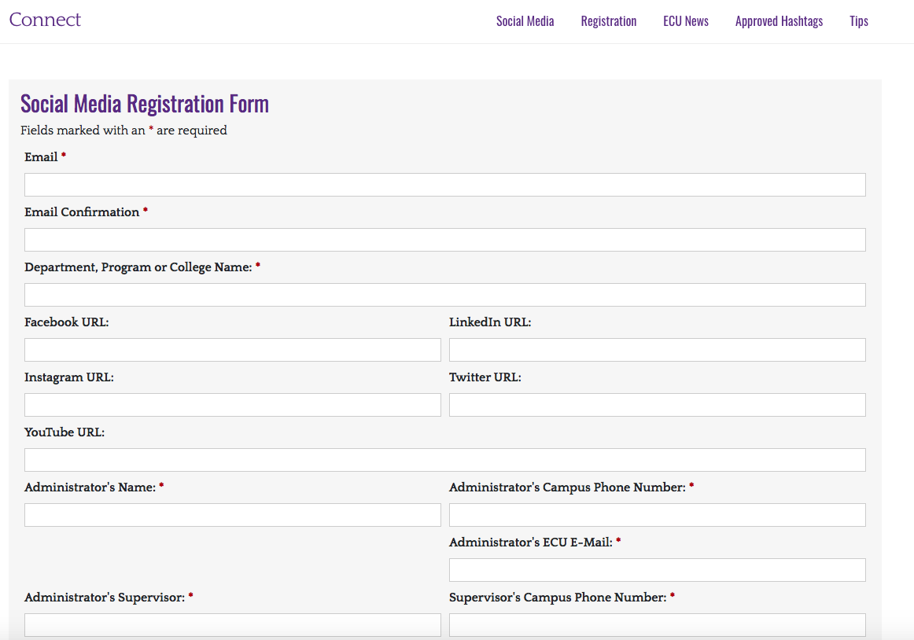
SOCIAL MEDIA ACCOUNT MAINTENANCE
BRANDED HASHTAGS | ACCOUNT REGISTRATION
To register your social media account with the University, we require:
- consistent content on the accounts for one month
Once the account is registered with the University, you can submit branded hashtags to be added to the University database at connect.ecu.edu/registration/

Slide 23
QUESTIONS?
How do you deal with negative responses on social media?
What is the timeline for event advertising? (resharing posts/brand your area)
How and when to use Instagram stories over feed posts? Takeovers?
How and when to leverage new platforms?
How to integrate social listening?

Slide 24
SOCIAL MEDIA ACTIVITY

